Slide 1



PYTHON – OUTPUT
In Python you use the print() function to get the program to
OUTPUT something to the screen.

Slide 2
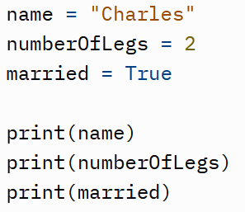
PYTHON – VARIABLES
All programming languages use VARIABLES.
A VARIABLE is simply a data value stored in the computer’s memory (RAM) while the program is running.
In the code, the variable is represented by a NAME. A bit like algebra, where data is represented by letters.
In the code you use the variable name to do different things with the stored data value.
Here are examples of how you create a VARIABLE.
1) Give it a NAME.
2) Then use the = operator to ASSIGN your variable a value.
Once you have data stored in your variables, you simply use the variable name in your code to use that data!

Slide 3
Calculations and Maths
Numerical data in variables can be used for mathematical operations. (+, -, *, /)
Z = x + y
answer = (number1 + number2) * 48
Remember when doing calculations that they are performed in a specific order!
Brackets
Orders/Indices/Exponent
Division
Multiplication
Addition
Subtraction
OPERATORS
Arithmetical Operators | + - * / % ** //
Assignment | =
Comparison/equality | == != > < >= <=

Slide 4
PYTHON – DATA TYPES
Integers (whole numbers)
Floating Point (decimals)
Strings (text etc.) “”
Booleans (true/false)
Collections:
Dictionaries (key-value pairs)
Lists (used instead of arrays in Python, changeable, ordered and indexed, square brackets [])
Tuples (unchangeable, ordered and indexed, normal brackets ())
Set (unchangeable, unordered, unindexed, curly brackets {})

Slide 5

PYTHON – INPUT
In Python you use the input() function to get the program to
take in a data value types in by the user
This means you can allow the user to enter the data into a program, rather than ‘hard-coding’ it into the program code!
You can also put a message string inside the brackets of the input function, so that the user is presented with instructions of what to enter!

Slide 6
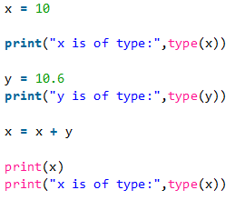
PYTHON – DATA TYPE CONVERSION
One of the issues you may encounter when using input(), is that it tends to treat all data entered by the user as a string (i.e. text).
So we may need to need to convert the data type of your variables.
Sometimes python will do this implicitly (automatically) for us:

Slide 7
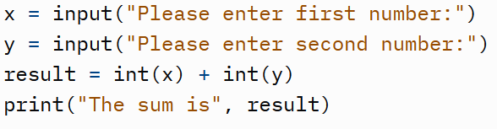
PYTHON – DATA TYPE CONVERSION
Often you might have to EXPLICITLY convert your data types – you can use one of the in-built conversion functions:
int()
float()
str()
There are more than these – you may have to research in the future.

Slide 8


LISTS
You create a list similarly to creating a VARIABLE.
But for a LIST, you use SQUARE BRACKETS around your data values that you are assigning to the list:

Slide 9

LISTS
[0]
[1]
[2]
Lists are INDEXED and ORDERED. This means that internally in memory, each position in the LIST has an identifying number. Items in the list remain in that order, according to their INDEX NUMBER. These numbers always start at zero.
You can then use these INDEX NUMBERS in your code to refer to individual positions (elements) within the list! i.e. change the value, or retrieve it

Slide 10



Lists
Lists can be of any data type, and contain MIXED DATA TYPES.
You can find out the number of items in a list by using the len() function

Slide 11
Data Structures
Officially, DATA STRUCTURES are ways of storing and organising data in a computer that allow efficient access to the data and operations to be performed on it.
In databases data is stored in a few different ways:
TABLES (in common RELATIONAL DATABASES)
KEY-VALUE PAIRS, DOCUMENTS, NODES etc (in NoSQL/NON-RELATIONAL DATABASES)
In spreadsheets, data is stored in ROWS and COLUMNS
In programming, data is stored in memory (RAM) via a variety of data structures such as VARIABLES, ARRAYS, LISTS, DICTIONARIES, STACKS, QUEUES

Slide 12
DATA STRUCTURES - CHARACTERISTICS
Typically DATA STRUCTURES have the following characteristics:
STATIC or DYNAMIC
Whether (or not) you can make the data structure BIGGER or SMALLER after creation.
MUTABLE or IMMUTABLE
Whether you can CHANGE the data values contained within – or not.
ORDERED or UNORDERED
Is the data in the structure stored rigidly in sequence, or not (randomly)

Slide 13
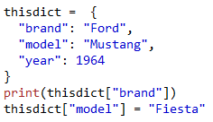
Dictionaries
Individual key-value pairs within the dictionary can be accessed using the KEY inside square brackets.

Slide 14


Tuples
TUPLES are similar to LISTS, however they are unchangeable (immutable).
Regular brackets () are used to create a TUPLE

Slide 15

Tuples
Like LISTS, TUPLES are indexed using a number.
Individual data values within a TUPLE can be accessed using the index number inside square brackets
*Note: Tuple are immutable – they cannot be changed after creation!

Slide 16
SETS
SETS do not use an index number, nor do they use keys.
When you PRINT the values in a SET, they will appear in a random order.
This means you cannot access individual data values – a SET is just a collection of values. You can of course still loop through them…
*Note: Sets are immutable – they cannot be changed after creation!

Slide 17


SETS
SETS are unchangeable (immutable), unordered and do not use index numbers.
Curly brackets/braces {} are used to create a SET

Slide 18
PYTHON – DATA TYPE CONVERSION
Often you might have to EXPLICITLY convert your data types – you can use one of the in-built conversion functions:
int()
float()
str()
There are more than these – you may have to research in the future.

Slide 19
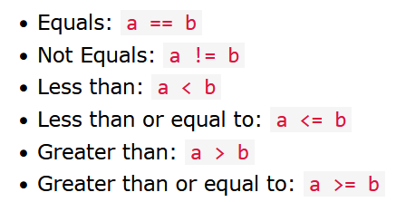
PYTHON – RELATIONAL OPERATORS
Like many languages, Python allows you to use RELATIONAL OPERATORS to compare data values/variables:
We use these in the BOOLEAN expressions inside IF statements!

Slide 20
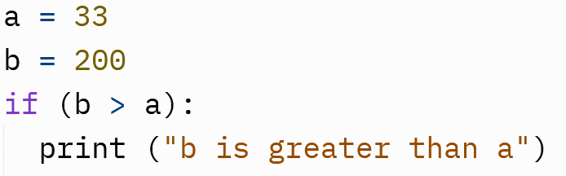
PYTHON – PROGRAMMING LOGIC
SELECTION/DECISIONS
IF STATEMENTS

Slide 21
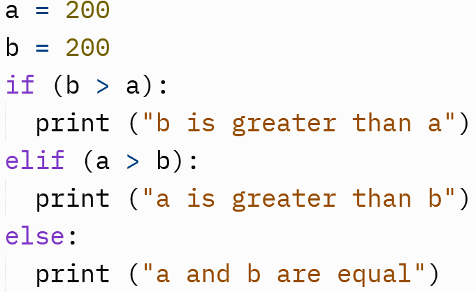
SELECTION/DECISIONS
ELIF stands for ‘Else If’. Basically using ELIF allows you to test more than one BOOLEAN EXPRESSION in the same IF statement.
ELIF STATEMENTS

